Slide 1

Project 2: Current Data Science and STEM Salaries in the United States
Data Science Bootcamp
Rich Kirschenheiter, Arielle Eagan, and Timothy Kelly

Slide 2
As future Data Science and STEM professionals, we are curious about the job market and earning potential in new roles available after we finish this Bootcamp….

Slide 3
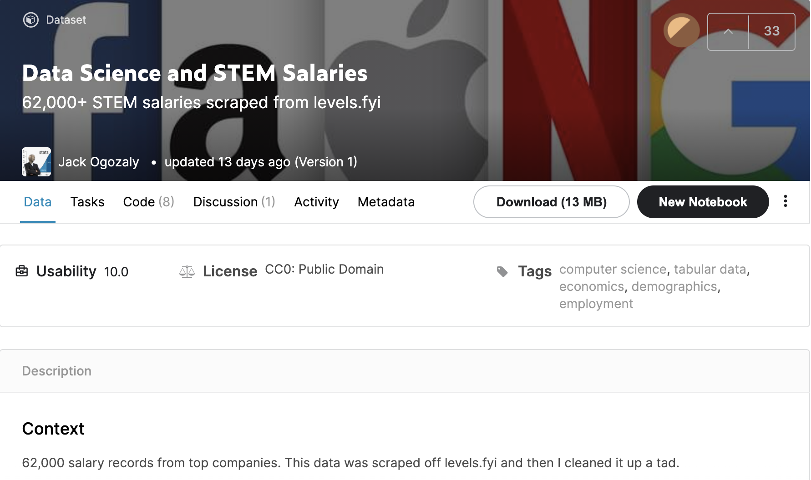
Our original data source:
Through Kaggle, we found a dataset of US-based Data Science and STEM Salaries available through Kaggle, which provides 62,000 salary records from top companies throughout the country.
Format: csv
Link: https://www.kaggle.com/jackogozaly/data-science-and-stem-salaries
Data set included:
company name
job title, location (city and state)
compensation (total yearly compensation as well as base salary, bonus, stock grants)
demographics (education level, gender, and race)

Slide 4
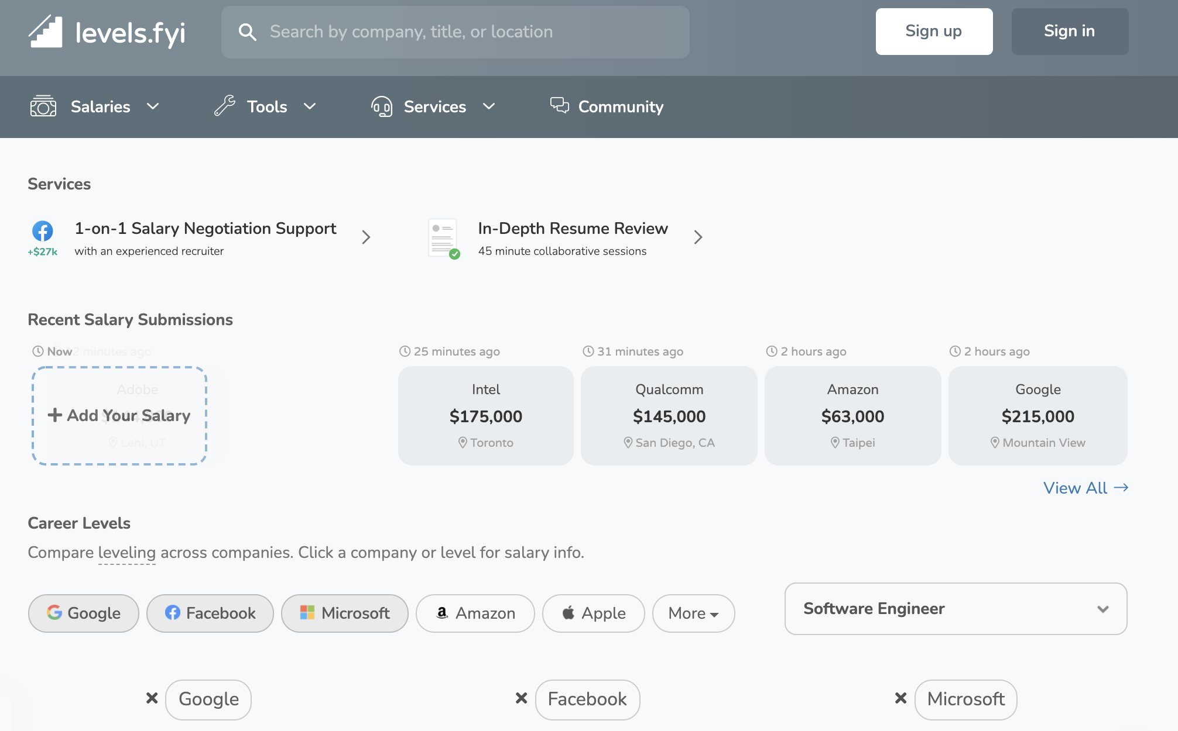
Adapting our data source:
Looking at the dataset’s source, we found that the data was scraped from a site called levels.fyi .
Link: https://www.levels.fyi/?compare=Google,Facebook,Microsoft&track=Software%20Engineer
Using this source, we found an API in JSON format that allowed us to pull more updated data, running only about 6 days behind current present day.
Though this did mean that we no longer had access to some demographic data (education level and race), we choose to use this API to ensure that our project and its visuals would have the most up-to-date data.

Slide 5
Cleaning the data: We used jupyter notebook to clean our data.
Steps we took to clean the data:
Analyzed data first
Cleaned missing data (NA values in rows)
Separated combined data points (Ex: “City, State” column separated to be “City” and “State” columns)
Filtered geographic levels (International filtered, US states filtered)

Slide 6
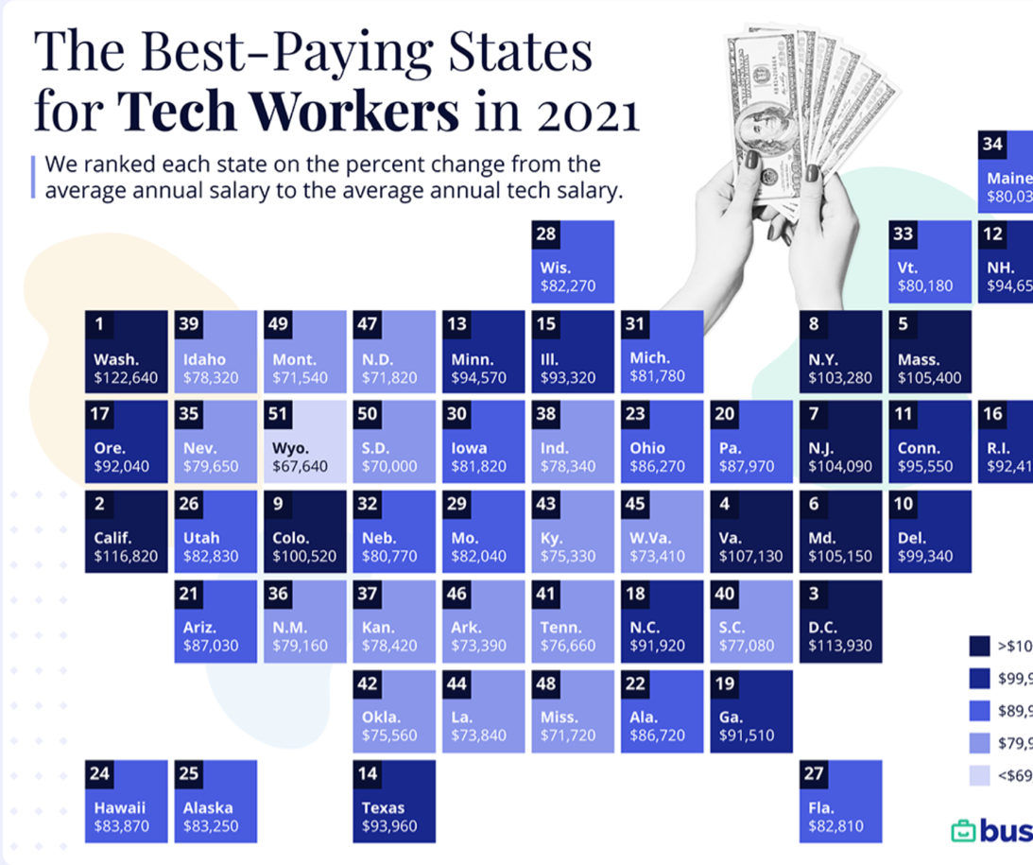
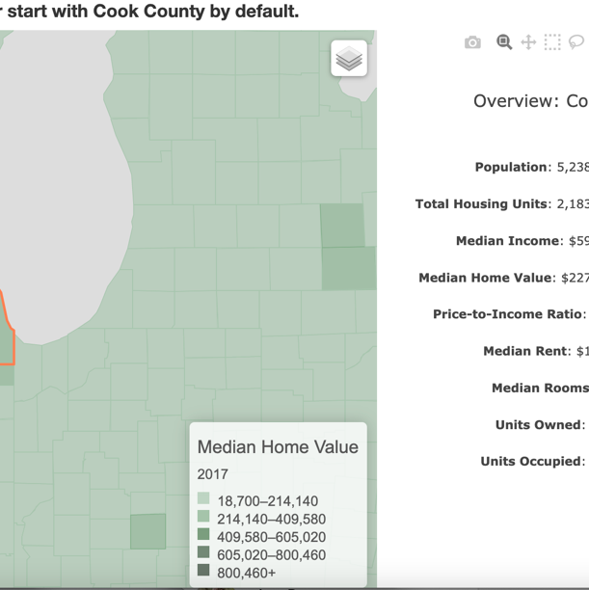
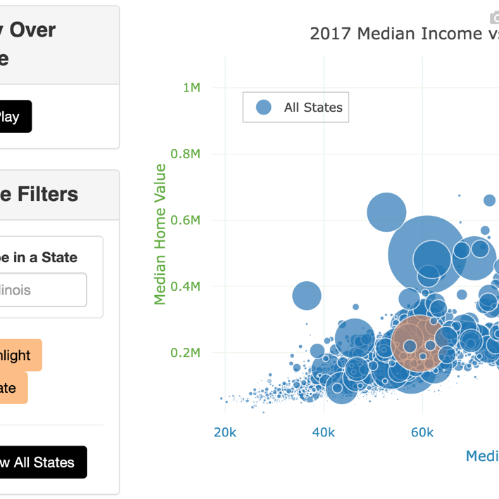
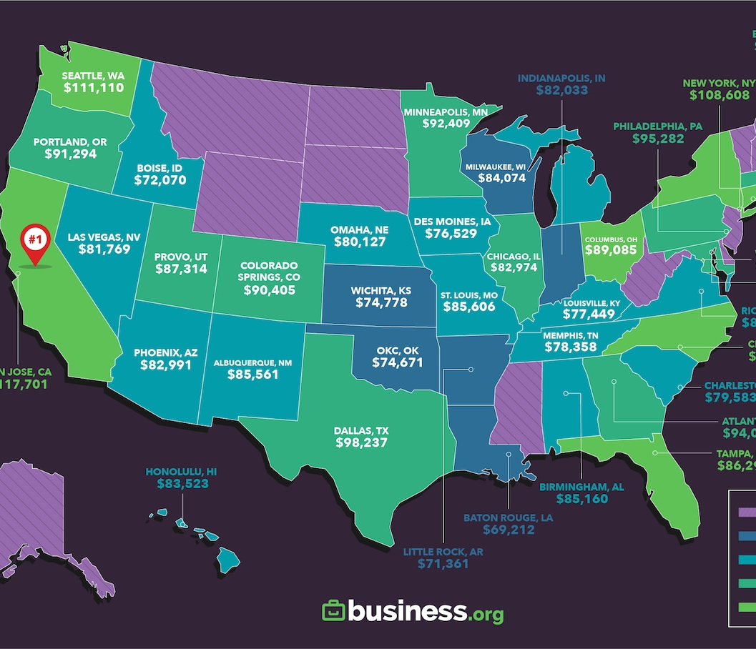
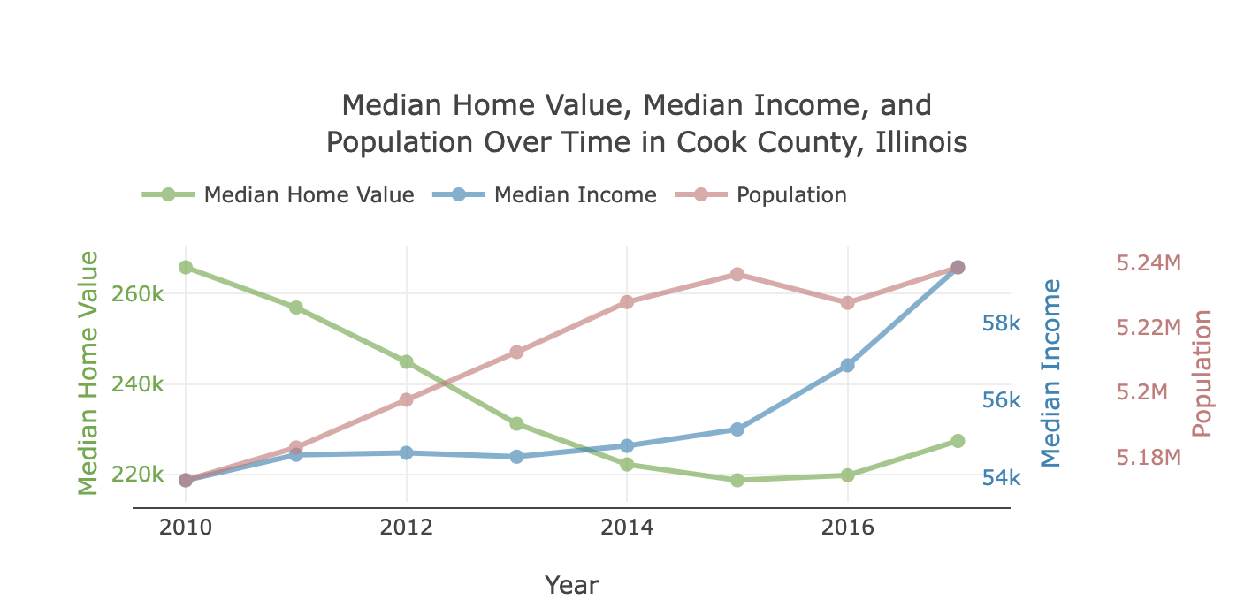
Scoping: We looked at interesting visualizations for ideas

Slide 7
Visualization 1: Interactive state-level salary map
interactive map of the US with state-level salary so that the user can explore Data Science and STEM companies, job titles, and associated salaries across the country

Slide 8
Visualization 2: Bubble map of salary and experience
bubble map to show the median base salary and median years of experience by state

Slide 9
Visualization 3: Median salary of top 3 companies (2017-current)
interactive line graph to show changing median salary for the top three most popular companies in the selected state on the map over the years (2017-current)

Slide 10
Limitations of data and visualizations
Lost education and race data
When we chose to use the source API (levels.fyi) instead of the Kaggle csv, we lost access to the education and race data. Though we chose the API for its up-to-date access on the overall information. However, with education and race as having documented impact on people’s access to certain jobs and salaries, we would hope to find a way to add these variables back in in future analysis to understand the impact these variables may have on salary access/discrimination.
Outliers
A number of outliers were found for total yearly compensation. This data could be valid, as there could be individuals who make very high salaries compared to others. However, this data could also signify possible errors in the data quality, such as incorrect input. To test this, we explored the compensation variables with boxplots, which then guided our decision to treat outliers as valid (and thus keep in data set) or to treat as errors (and thus discard).
OTHER

